Slide 1

ARE PEOPLE Bypassing MFA & WHAT ABOUT COOKIES
….
Notes:
Cybersecurity Awareness.

Slide 2
Jesse Moore UW | UWB Sr. Cybersecurity Advisor
REN-ISAC Pentester (Hacker)
REN-ISAC Peer Assessment video
CyberForce Core Red Team
Department of Energy's CyberForce® Program
Pacific Rim Collegiate Cyber Defense Competition -Red Team
CCDC Regionals (nationalccdc.org)
Notes:
https://www.ren-isac.net/member-resources/rimm/2022_videos/peer_assessment1.html
https://cyberforce.energy.gov/
https://www.nationalccdc.org/index.php/competition/competitors/ccdc-regionals

Slide 3
Agenda
Video of MFA bypass attack with Evilgnix2
Slack (Electron) Attack with cookies
Chrome Cookies
MSFT Tokens & Device Codes

Slide 4
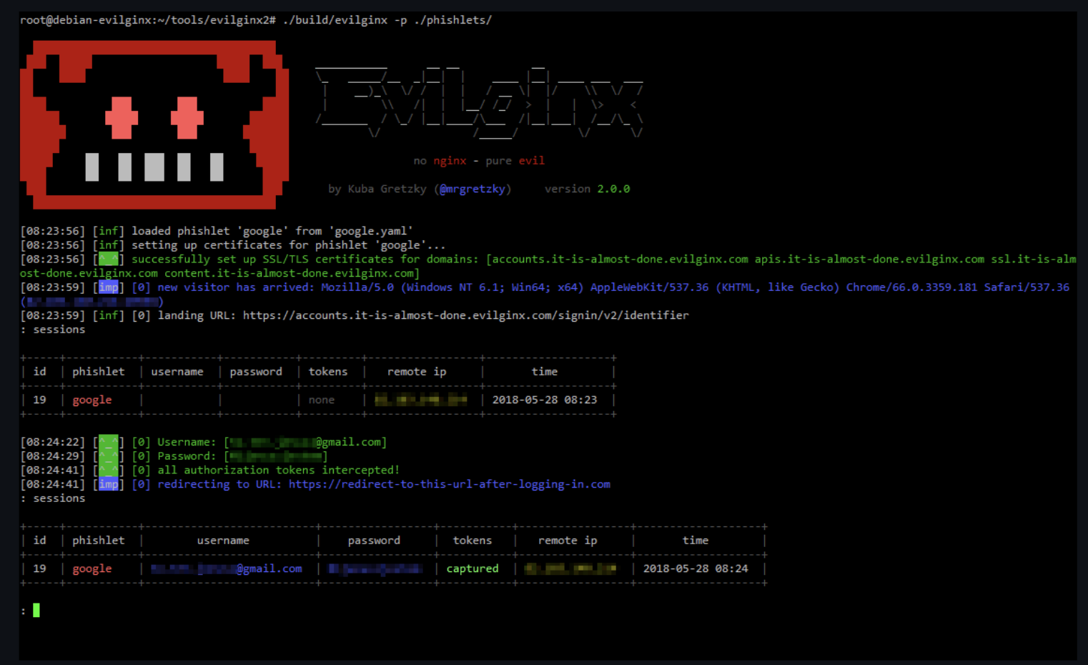
Video of Evilginx2 bypass MFA
….
https://www.youtube.com/watch?v=GDVxwX4eNpU
Notes:
Did you know MFA could be bypassed? Lets check out a video demo and hear about more ways people can use your cookies to impersonate you!
GitHub - kgretzky/evilginx2: Standalone man-in-the-middle attack framework used for phishing login credentials along with session cookies, allowing for the bypass of 2-factor authentication
https://github.com/warhorse/docker-evilginx2
There are ways to bypass MFA, and attackers are trying them all: rogue apps, vulnerabilities, legacy authentication protocols, spamming a target user with MFA prompts, and others.

Slide 5


There will be a new training course soon! Evilginx3
….
https://twitter.com/mrgretzky/status/1580148354066939904?s=20&t=wWpYRvDKL6TnnmqqUT7kGA

Slide 6
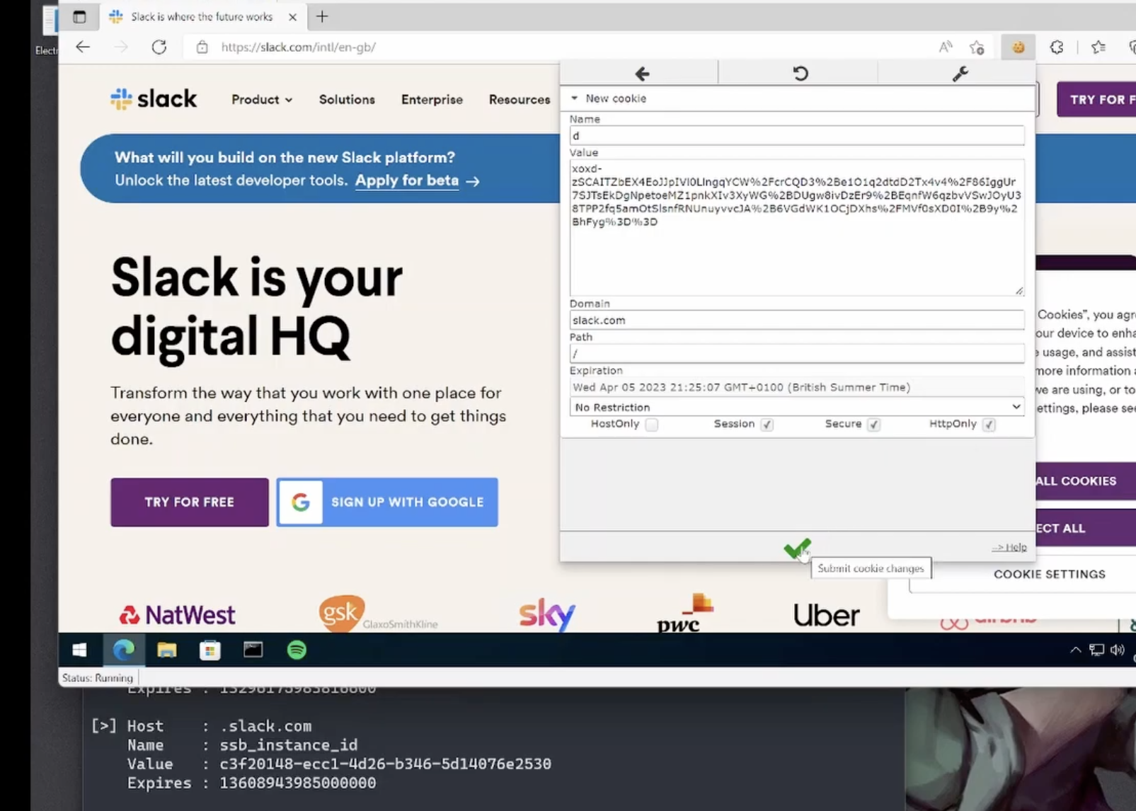
SLACK COOKIES 2 login as you!
….
https://github.com/FuzzySecurity/WWHF-WayWest-2022
Notes:
IBM X-FORCE REDTEAM Fuzzy Sec
https://github.com/FuzzySecurity/WWHF-WayWest-2022

Slide 7

WHO ELSE uses Electron APPS?
Notes:
Teams cookies via Crackmapexec: https://twitter.com/mpgn_x64/status/1582450167432634370?s=20&t=MeSYWG3Zfn5riWd7jvUbWw

Slide 8
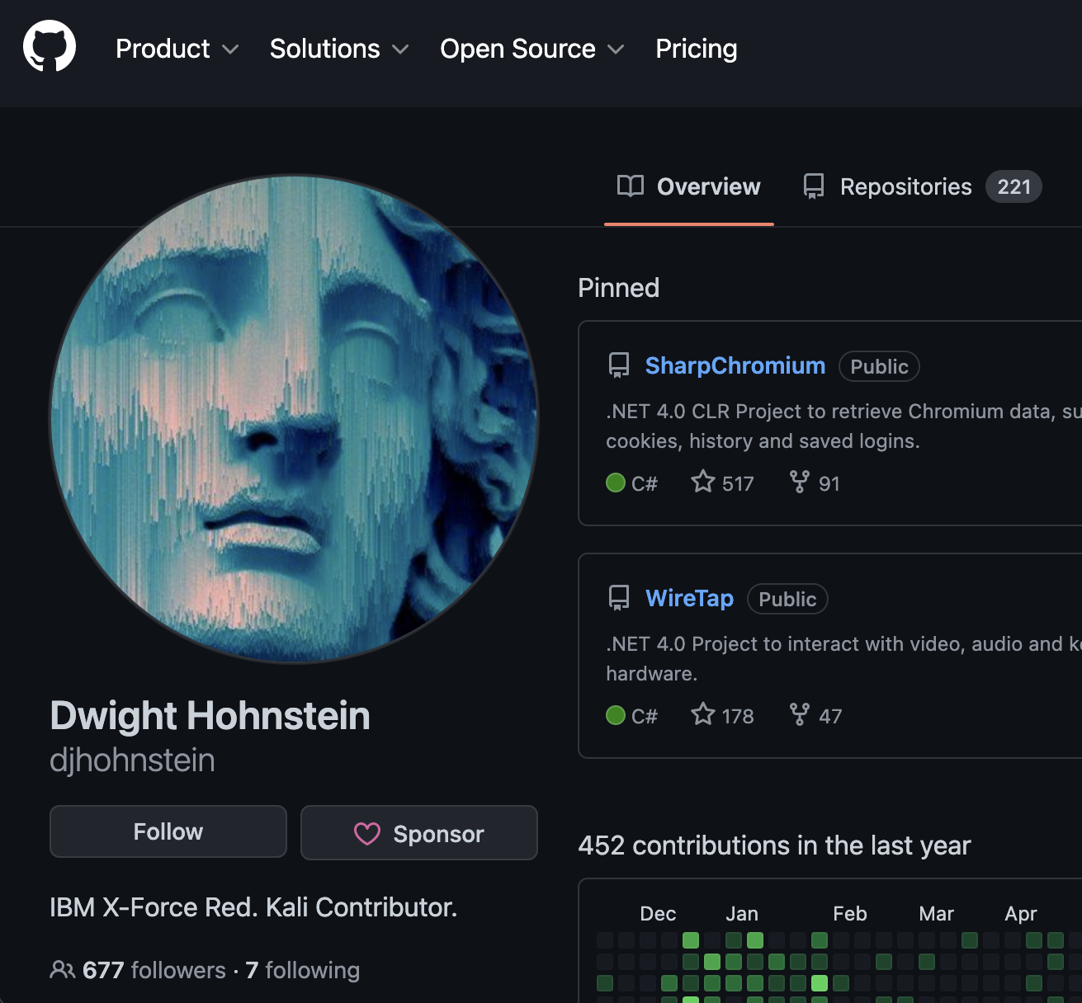
SHARPCHROME
https://github.com/djhohnstein/SharpChromium
Who Cares? I can login as you:
Websites that use cookies to allow you to stay logged in.
https://samsclass.info/123/proj10/cookie-reuse.htm
Video Demo :https://www.youtube.com/watch?v=ofx_uzP6qt4
Notes:
https://github.com/djhohnstein/SharpChromium
Stealing an o365 cookie from Edge to bypass authentication and 2FA Youtube:
https://www.youtube.com/watch?v=ofx_uzP6qt4
https://www.coresecurity.com/core-labs/articles/reading-dpapi-encrypted-keys-mimikatz
https://samsclass.info/123/proj10/cookie-reuse.htm#steps
Stealing cookies on edge and login into o365
(455) Stealing an O365 cookie from Edge to "bypass" authentication and 2FA - YouTube
https://www.youtube.com/watch?v=ofx_uzP6qt4
ProofPoint article on MFA Bypass via cookies:
https://www.helpnetsecurity.com/2022/02/04/phishing-kits-bypass-mfa/
https://www.proofpoint.com/us/blog/threat-insight/mfa-psa-oh-my

Slide 9
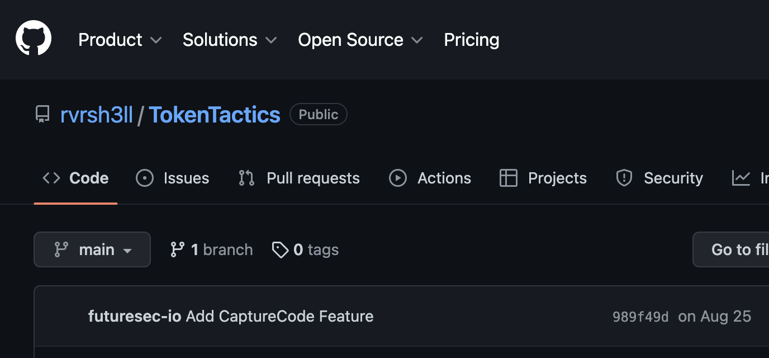
Token Tactics & Device Codes
MSFT Device codes Token tactics:
GitHub - rvrsh3ll/TokenTactics: Azure JWT Token Manipulation Toolset
Phishing with Microsoft 365 and Microsoft Device Codes | Steve Borosh - YouTube
Notes:
https://learn.microsoft.com/en-us/samples/azure-samples/active-directory-dotnetcore-devicecodeflow-v2/invoke-protected-api-text/
Phishing with Microsoft 365 and Microsoft Device Codes | Steve Borosh – YouTube:
https://www.youtube.com/watch?v=jbUJ2NsZgcE&t=165s
Printers allowed to send emails internally.
https://learn.microsoft.com/en-us/exchange/mail-flow-best-practices/how-to-set-up-a-multifunction-device-or-application-to-send-email-using-microsoft-365-or-office-365
ProofPoint:
MFA PSA, Oh My! | Proofpoint US
https://www.proofpoint.com/us/blog/threat-insight/mfa-psa-oh-my
https://www.antisyphontraining.com/enterprise-attack-initial-access-w-steve-borosh/

Slide 10
Take aways
If an email or Slack/Team message/website feels strange, then call the person or …
Use Regular account and not Admin <-Adversaries Hunt Admins
O365 Session Detection –MSFT Defender for Endpoint, Configure email protections
Logging (Sysmon, etc) and detection (or EDR) to see if someone is in your system or using your access.
Ciso.uw.edu for more Risk advisories.
Notes:
Be suspicious of too good to be true scenarios or odd scenarios just like with phishing.
Use regular accounts not Admin
ProofPoint configs for Phishing as Printer internally.
https://atomicredteam.io/credential-access/T1539/

Slide 11
Any questions?
Notes:
Be suspicious of too good to be true scenarios or odd scenarios just like with phishing.

Slide 12

Thank YOU!
Email: moorej1@uw.edu

